Slide 1

Adaptive Moment Estimation (Adam)
Presented by:
Elizer Ponio Jr.
Department of Computer Science
College of Computing and Information Technologies

Slide 2
Outline
Recap of Optimization Algorithms
Building a basic Sentiment Model

Slide 3
Optimization Algorithm
In deep learning, we have the concept of loss, which tells us how poorly the model is performing at that current instant. Now we need to use this loss to train our network such that it performs better.
Essentially what we need to do is to take the loss and try to minimize it, because a lower loss means our model is going to perform better.
The process of minimizing (or maximizing) any mathematical expression is called optimization.

Slide 4
How do Optimizers work?
You can think of a hiker trying to get down a mountain with a blindfold on. It’s impossible to know which direction to go in, but there’s one thing she can know: if she’s going down (making progress) or going up (losing progress).
Eventually, if she keeps taking steps that lead her downwards, she’ll reach the base.
Similarly, it’s impossible to know what your model’s weights should be right from the start. But with some trial and error based on the loss function (whether the hiker is descending), you can end up getting there eventually.
How you should change your weights or learning rates of your neural network to reduce the losses is defined by the optimizers you use. Optimization algorithms are responsible for reducing the losses and to provide the most accurate results possible.

Slide 5
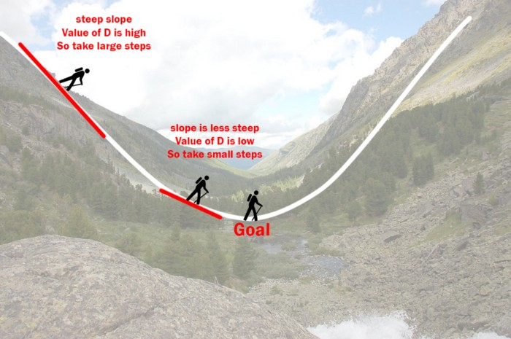
How do Optimizers work?
You can think of a hiker trying to get down a mountain with a blindfold on. It’s impossible to know which direction to go in, but there’s one thing she can know: if she’s going down (making progress) or going up (losing progress).

Slide 6
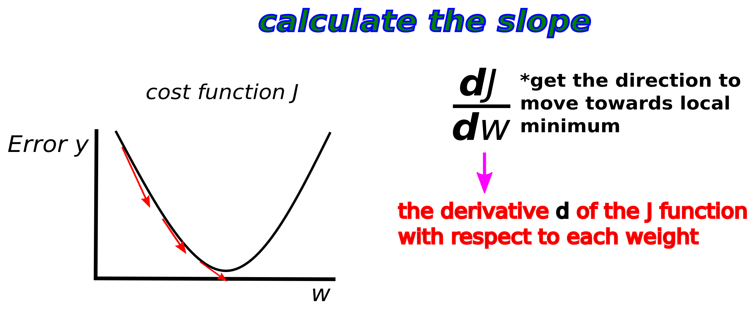
Recap: Gradient Descent

Slide 7
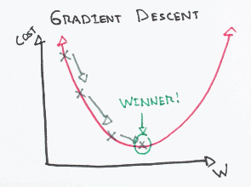
How do Optimizers work?
Eventually, if she keeps taking steps that lead her downwards, she’ll reach the base.
Similarly, it’s impossible to know what your model’s weights should be right from the start. But with some trial and error based on the loss function (whether the hiker is descending), you can end up getting there eventually.

Slide 8
How do Optimizers work?
How you should change your weights or learning rates of your neural network to reduce the losses is defined by the optimizers you use.
Optimization algorithms are responsible for reducing the losses and to provide the most accurate results possible.

Slide 9
Various Optimizers
Gradient Descent
Stochastic Gradient Descent (SGD)
Mini Batch Stochastic Gradient Descent (MB-SGD)
SGD with momentum
Nesterov Accelerated Gradient (NAG)
Adaptive Gradient (AdaGrad)
AdaDelta
RMSprop
Adam

Slide 10
Adam
Adam stands for Adaptive Moment Estimation.
Adaptive Moment Estimation (Adam) is another method that computes adaptive learning rates for each parameter.
In addition to storing an exponentially decaying average of past squared gradients like AdaDelta ,Adam also keeps an exponentially decaying average of past gradients M(t), similar to momentum:

Slide 11
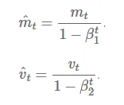
Adam

Slide 12

Adam

Slide 13
Adam
Adam works well in practice and compares favorably to other adaptive learning-method algorithms as it converges very fast and the learning speed of the Model is quiet, fast and efficient and also it rectifies every problem that is faced in other optimization techniques such as vanishing Learning rate, slow convergence or High variance in the parameter updates which leads to fluctuating Loss function

